Slide 1
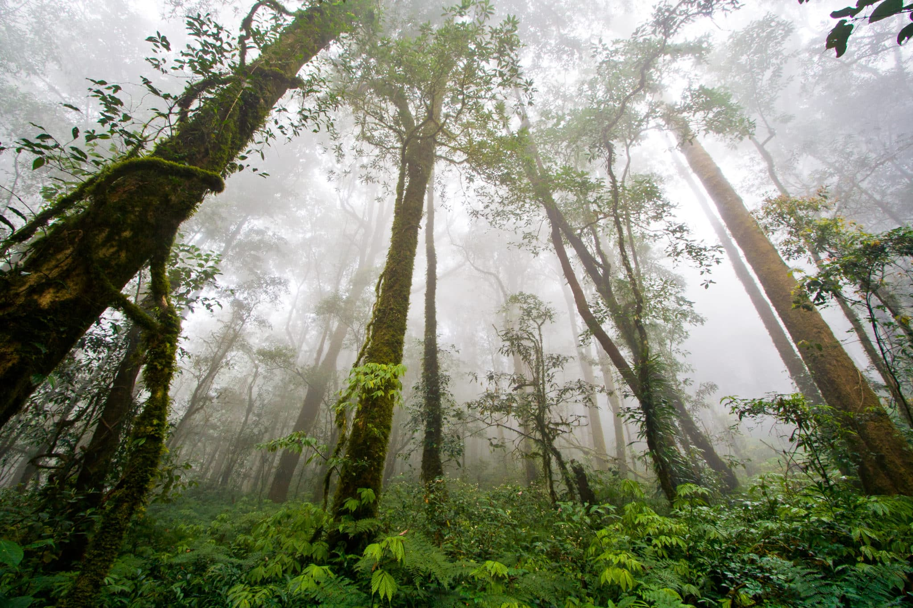
A novel approach towards continuous monitoring of forest change dynamics in fragmented landscapes using time series Landsat imagery
Jingmiao Fei
MUSA 6500
Cover Image Source: https://foundtheworld.com/amazon-rainforest/

Slide 2
Background
Forests are the largest terrestrial ecosystems on Earth and play an important role in global carbon cycling, climate regulation, and biodiversity conservation. However, in recent years, forest fragmentation has intensified due to human activities (such as small-scale logging, selective logging) and natural factors, leading to enhanced edge effects and increased carbon emissions.
Since these changes are usually low-intensity and small-scale, they are difficult to detect effectively using remote sensing data with medium spatial resolution (such as Landsat). Therefore, a more precise method is urgently needed to monitor the dynamic changes of fragmented forests.

Slide 3
Purpose
This study aims to develop a generalized approach based on the PFI that can better track changes in fragmented forest landscapes.
specific objectives:
present a new index, Pure Forest Index (PFI) to enhance the observed signal response of the pixel caused by sub-pixel forest changes;
apply the new method to the Amazon and interpret the spatial and temporal patterns;
compare the proposed method against commonly used VIs and similar State-of-the-Art (SOTA) approaches.

Slide 4
Methods
This study developed a new index, the Pure Forest Index (PFI), and combined it with the Continuous Change Detection and Classification algorithm (CCDC) to form the CCDC-PFI algorithm for forest change monitoring in the Amazon rainforest .
The main research steps are as follows:
Data acquisition and preprocessing: Landsat TM, ETM+, and OLI data were used, and atmospheric correction, cloud occlusion removal, and time series normalization were performed.
PFI index development: Spectral mixture analysis (SMA) and vegetation index (VI) were combined to remove non-forest background information in pixels to enhance the signal of forest change.
CCDC-PFI algorithm application: The CCDC algorithm was used to fit the PFI time series, detect the mutation points of forest change, and classify them as forest loss, forest recovery, or stable state.

Slide 5
Methods - PFI index
The main innovation of the method is the development of the PFI index.
In remote sensing, each pixel’s surface reflectance is a mix of various components (e.g., forest, soil, non-vegetated areas) with different proportions. In heterogeneous areas, small proportions of certain components may not significantly affect the overall reflectance or vegetation index (VI), making subtle forest changes hard to detect with traditional remote sensing methods.
PFI addresses this by enhancing forest reflectance variations and reducing background(including NPV, soil, cloud and shade in this research) interference. The contribution of the background to a pixel is represented by the product of the background endmember standard VI value and its corresponding abundance. It calculates the VI of the "pure forest" part of the pixel by removing background influences, offering a more accurate reflection of forest changes.
Main steps:
Using the VI of all components as a basis.
Interpolating to remove the background effects.
Extracting the VI representing only the forest area.

Slide 6
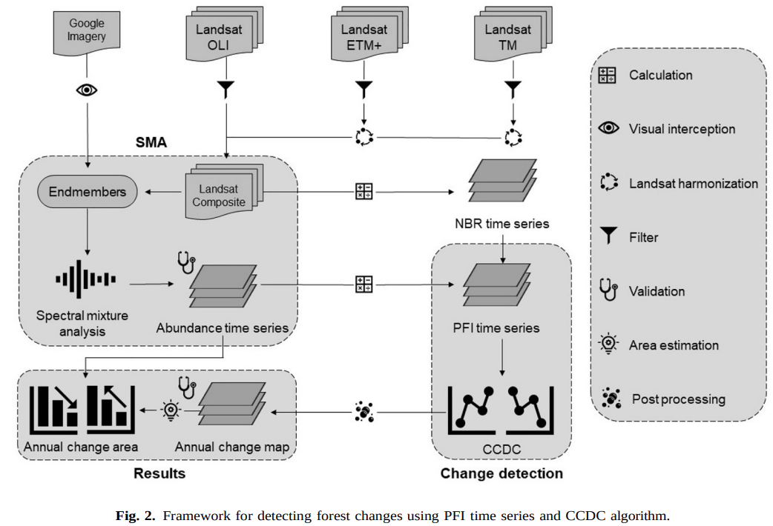
Methods
As introduced on the previous page, the figure below shows the framework of the entire method.

Slide 7
Key takeaways
Forest change trends：
Forest loss far exceeds forest recovery: Between 1986 and 2020, the Amazon rainforest experienced a net loss of 383,452 km², with 433,877 km² of forest lost and only 50,425 km² recovered.
Deforestation accelerated significantly after 2000, primarily in the southern Brazilian Amazon, gradually expanding northward.
High accuracy of the new method:
The CCDC-PFI method outperforms traditional vegetation index (VI) methods and existing approaches such as CODED and CCDC-SMA, improving detection accuracy by 0.02–0.35.
Achieves an overall accuracy (OA) of 0.94 ± 0.03, with a temporal error of only 0.83 years.
Policy Implications:
Enables more precise carbon emission assessments.

Slide 8
Futher thoughts
How can the Pure Forest Index (PFI) be integrated with real-time satellite monitoring and deep learning to predict and enhance early detection and prevention of deforestation in other fragmented forest regions?

Slide 9
Reference
Cai, Y., Shi, Q., Xu, X., & Liu, X. (2023). A novel approach towards continuous monitoring of forest change dynamics in fragmented landscapes using time series Landsat imagery. International Journal of Applied Earth Observation and Geoinformation, 118, 103226. https://doi.org/10.1016/j.jag.2023.103226

